Slide 1
Assalamualikum
Name: Afrin
Roll: 03
Topic: “Long-Term Traditional Fertilization Alters Tea Garden Soil Properties and Tea Leaf Quality in Bangladesh”

Slide 2
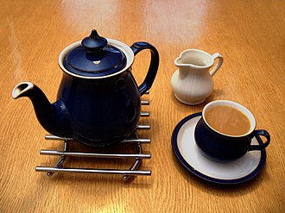
What is tea?
Tea is an aromatic beverage prepared by pouring hot or boiling water over cured or fresh leaves of Camellia sinensis, an evergreen shrub native to East Asia which probably originated in the borderlands of south-western China and northern Myanmar. Tea is also made, but rarely, from the leaves of Camellia taliensis. After plain water, tea is the most widely consumed drink in the world. There are many different types of tea; some have a cooling, slightly bitter, and astringent flavour,while others have profiles that include sweet, nutty, floral, or grassy notes. Tea has a stimulating effect in humans, primarily due to its caffeine content

Slide 3
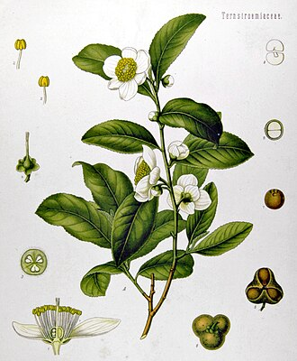
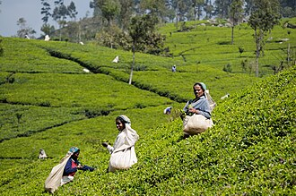
Tea Plant
Tea plants are native to East Asia and the probable center of origin of tea is near the source of the Irrawaddy River from where it spread out fan-wise into southeast China, Indo-China and Assam. Thus, the natural home of the tea plant is considered to be within the comparatively small fan-shaped area between Nagaland, Manipur and Mizoram along the Burma frontier in the west, through China as far as the Zhejiang Province in the east, and from this line generally south through the hills to Burma and Thailand to Vietnam. The west–east axis indicated above is about 2,400 km long extending from longitude 95°-120°E. The north–south axis covers about 1,920 km, starting from the northern part of Burma, latitude 29°N passing through Yunnan, Tongkin, Thailand, Laos and on to Annan, reaching latitude 11°N.

Slide 4
Soil Properties of Tea
Tea grounds act as an organic matter that can improve soil structure and drainage:
Nitrogen Content: Tea leaves are an excellent source of nitrogen, a fundamental building block for plant growth.
Mulching: Spread around plants, tea grounds can serve as mulch, retaining moisture and suppressing weeds.
Compost: Adding tea bags to compost bins boosts the decomposition process, enriching the compost with minerals like magnesium.

Slide 5
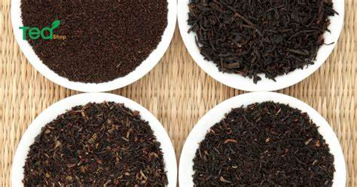
Tea Leaf Quality in Bangladesh
The “Tea Leaf Age Quality” dataset represents a pioneering agricultural and machine-learning resource to enhance tea leaf classification, detection, and quality prediction based on leaf age. This comprehensive collection includes 2208 raw images from the historic Malnicherra Tea Garden in Sylhet.

Slide 6
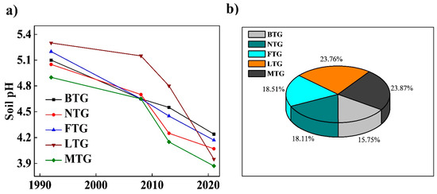
Age of different Tea Garden in Bangladesh From 1990- 2020. The Bar Diagram shows a comparison.

Slide 7
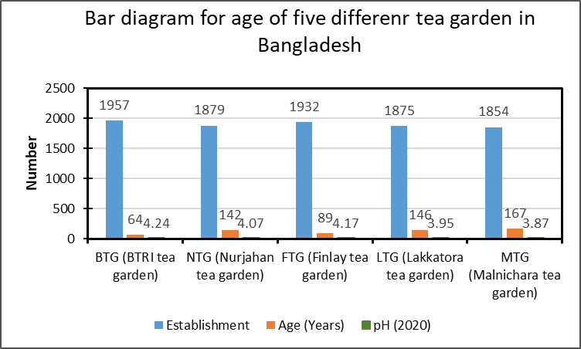
Comparison for diffident Tea garden in Bangladesh according to Age, pH and Establishment
Garden neme | Establishment | Age (Years) | pH (2020)
BTG (BTRI tea garden) | 1957 | 64 | 4.24
NTG (Nurjahan tea garden) | 1879 | 142 | 4.07
FTG (Finlay tea garden) | 1932 | 89 | 4.17
LTG (Lakkatora tea garden) | 1875 | 146 | 3.95
MTG (Malnichara tea garden) | 1854 | 167 | 3.87

Slide 8
Oolong Tea
Green Tea
Types of Tea
Black Tea
Yellow Tea
White Tea

Slide 9


